Slide 1
Python week 1
Canberra Chinese School Sem2

Slide 2
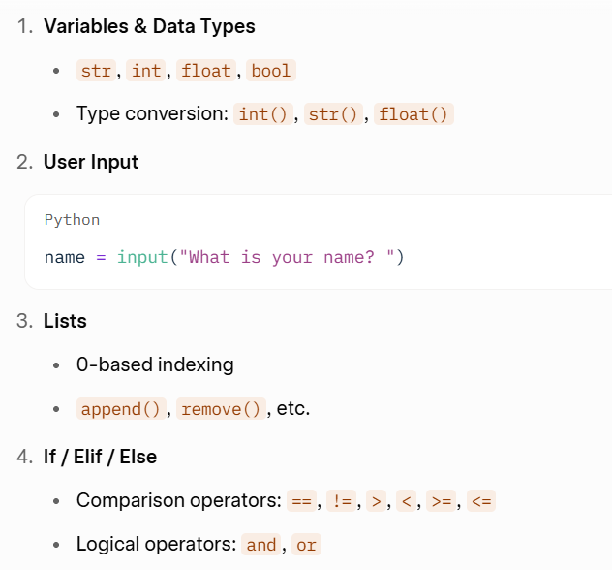

Review

Slide 3
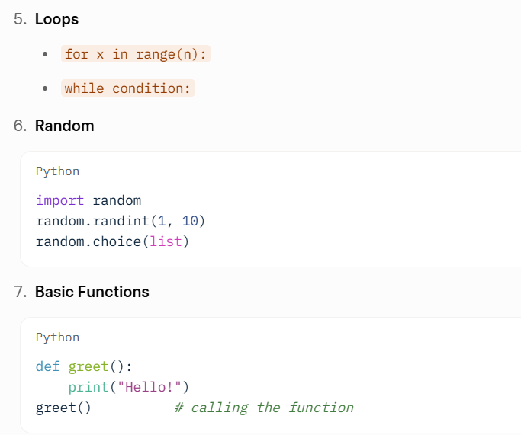
Review

Slide 4
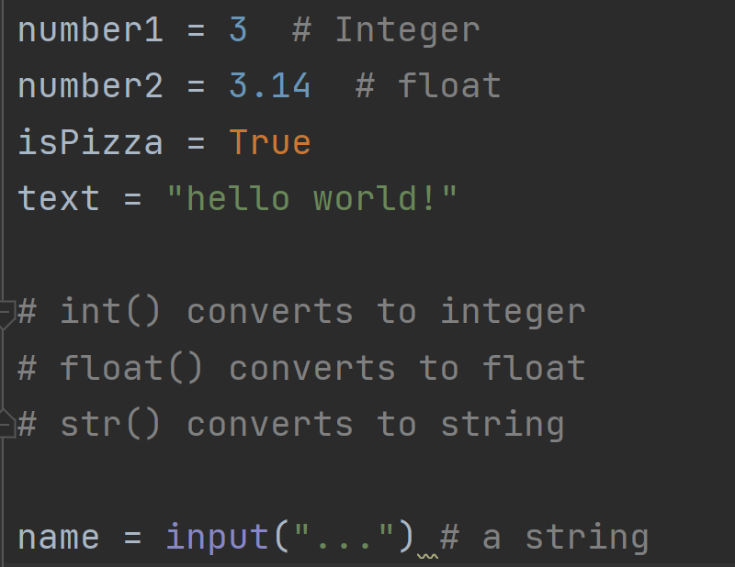
Review

Slide 5
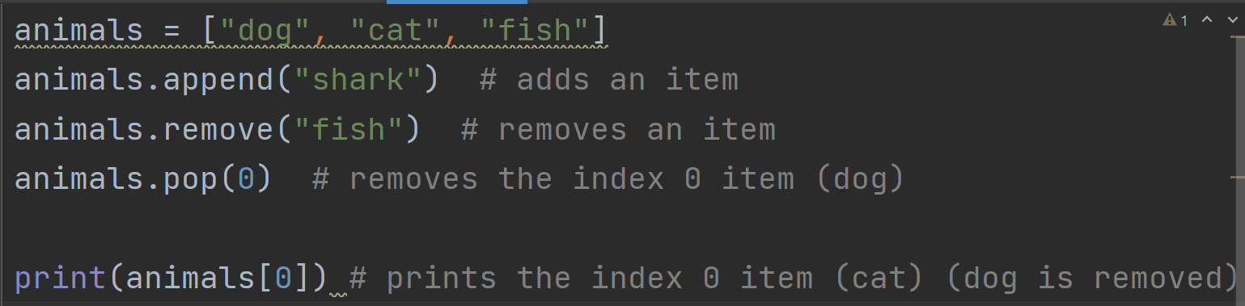
Review

Slide 6
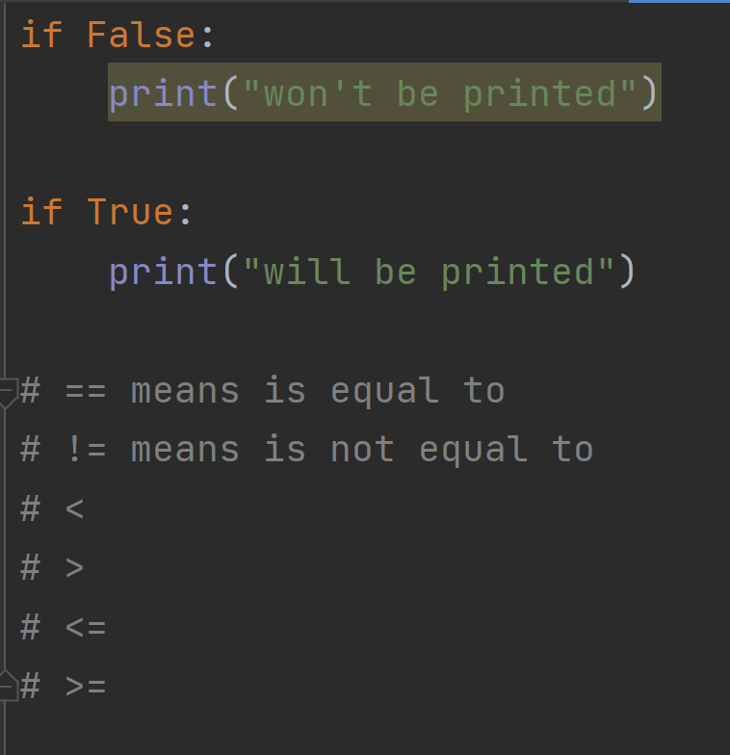
Review

Slide 7
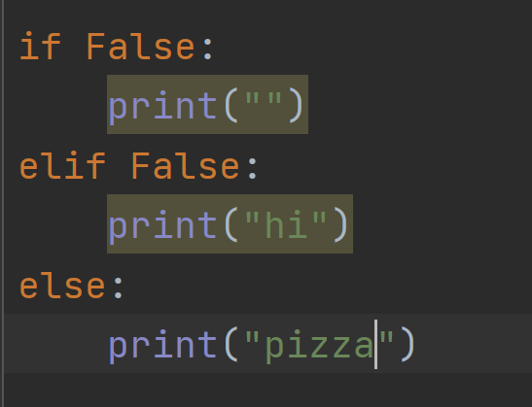
Review

Slide 8
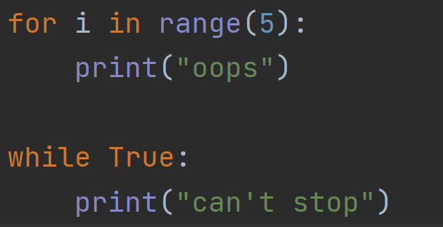
Review

Slide 9
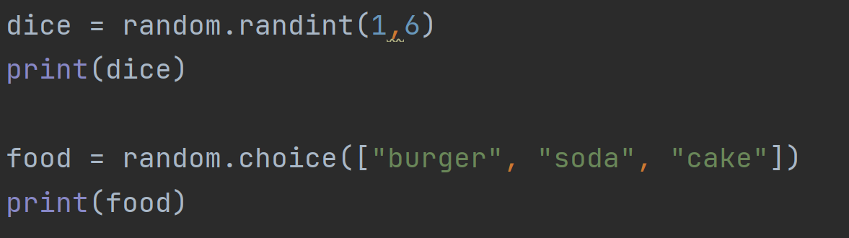
Review

Slide 10
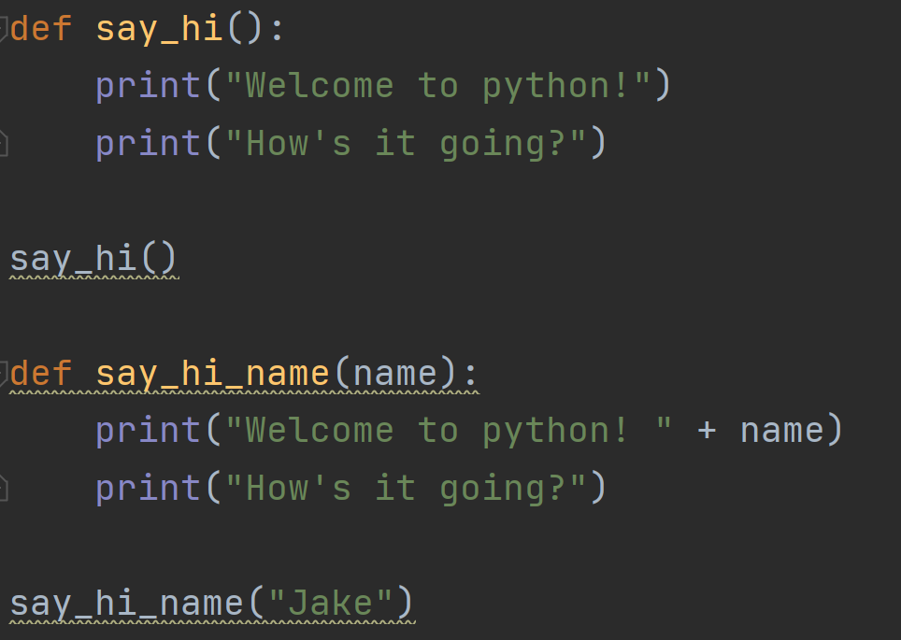
Review

Slide 11
New content: return
In Semester 1, our functions only printed things on the screen.But what if we want a function to calculate something and give the result back so we can use it later?
def function:
…
return …

Slide 12
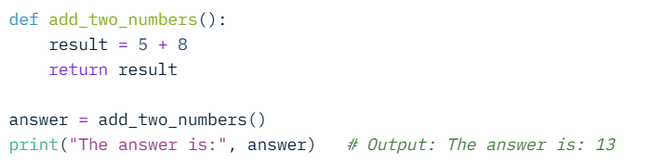
Return

Slide 13
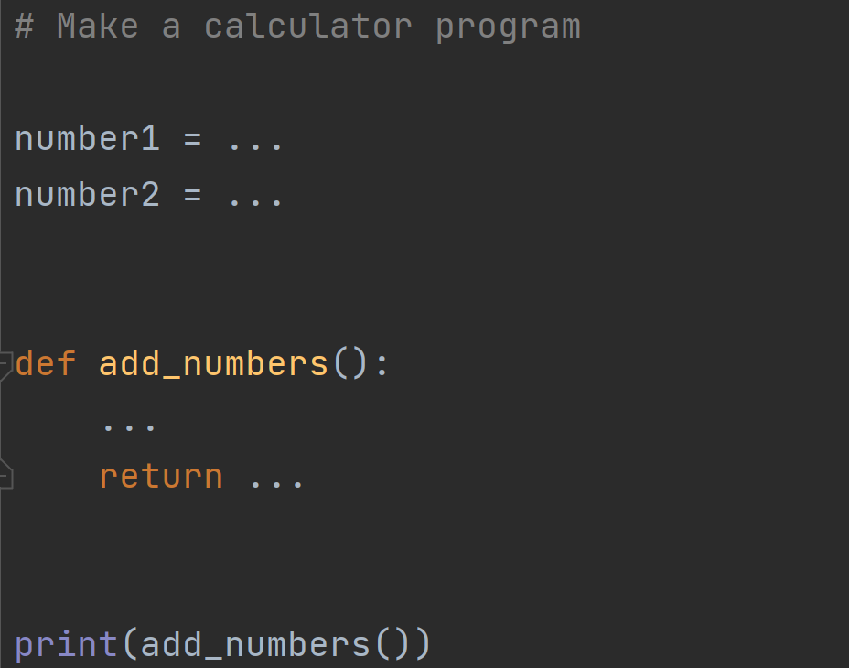
Exercise
Make an exercise program that adds two numbers

Slide 14
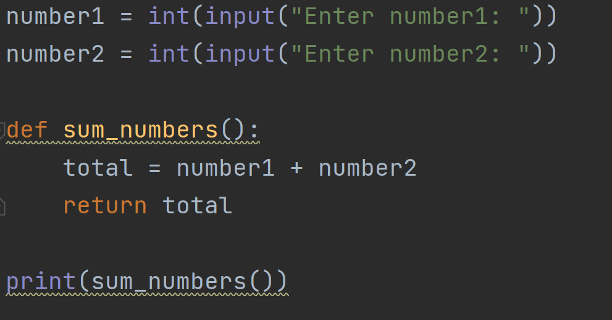
Exercise answer

